Slide 1

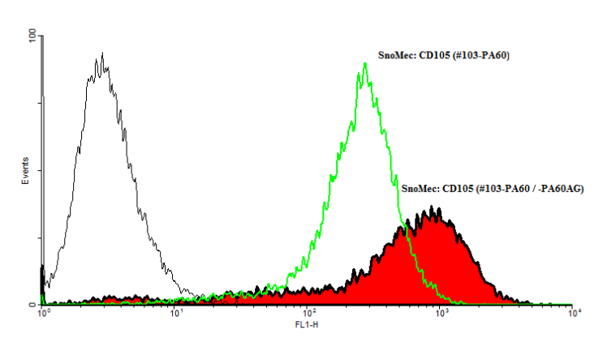
ReliaTech GmbH
Rabbit anti-mouse CD105/Endoglin
(Cat #103-PA60 / 103-PA60AG)
Fig. 1: FACS analysis with primary mouse endothelial cells (SnoMec).
http://www.reliatech.de / orders@reliatech.de

